Slide 1
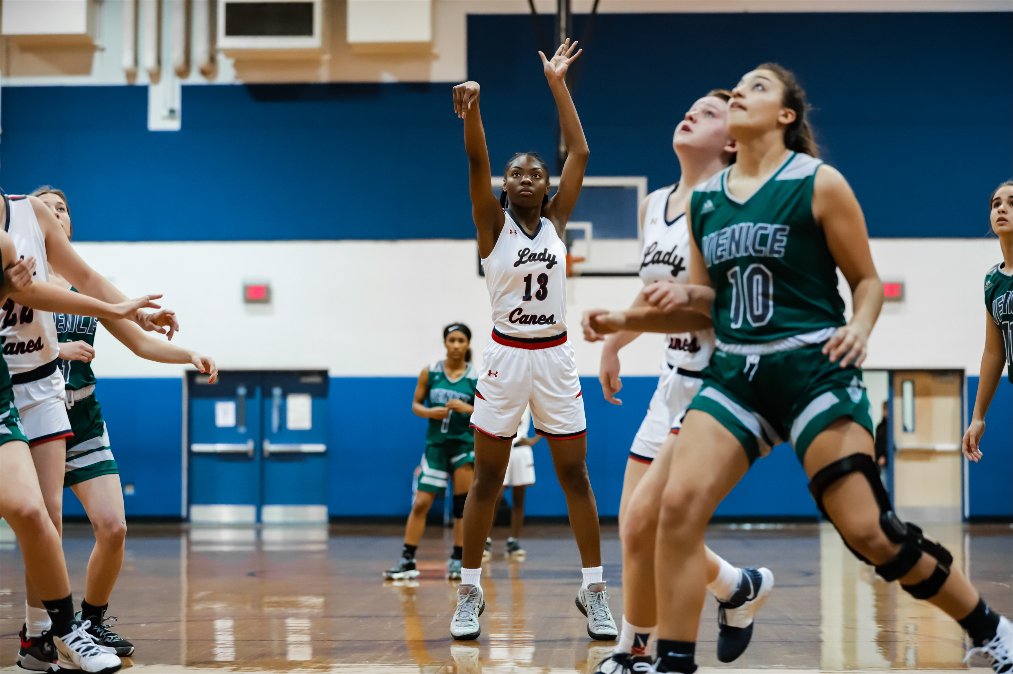
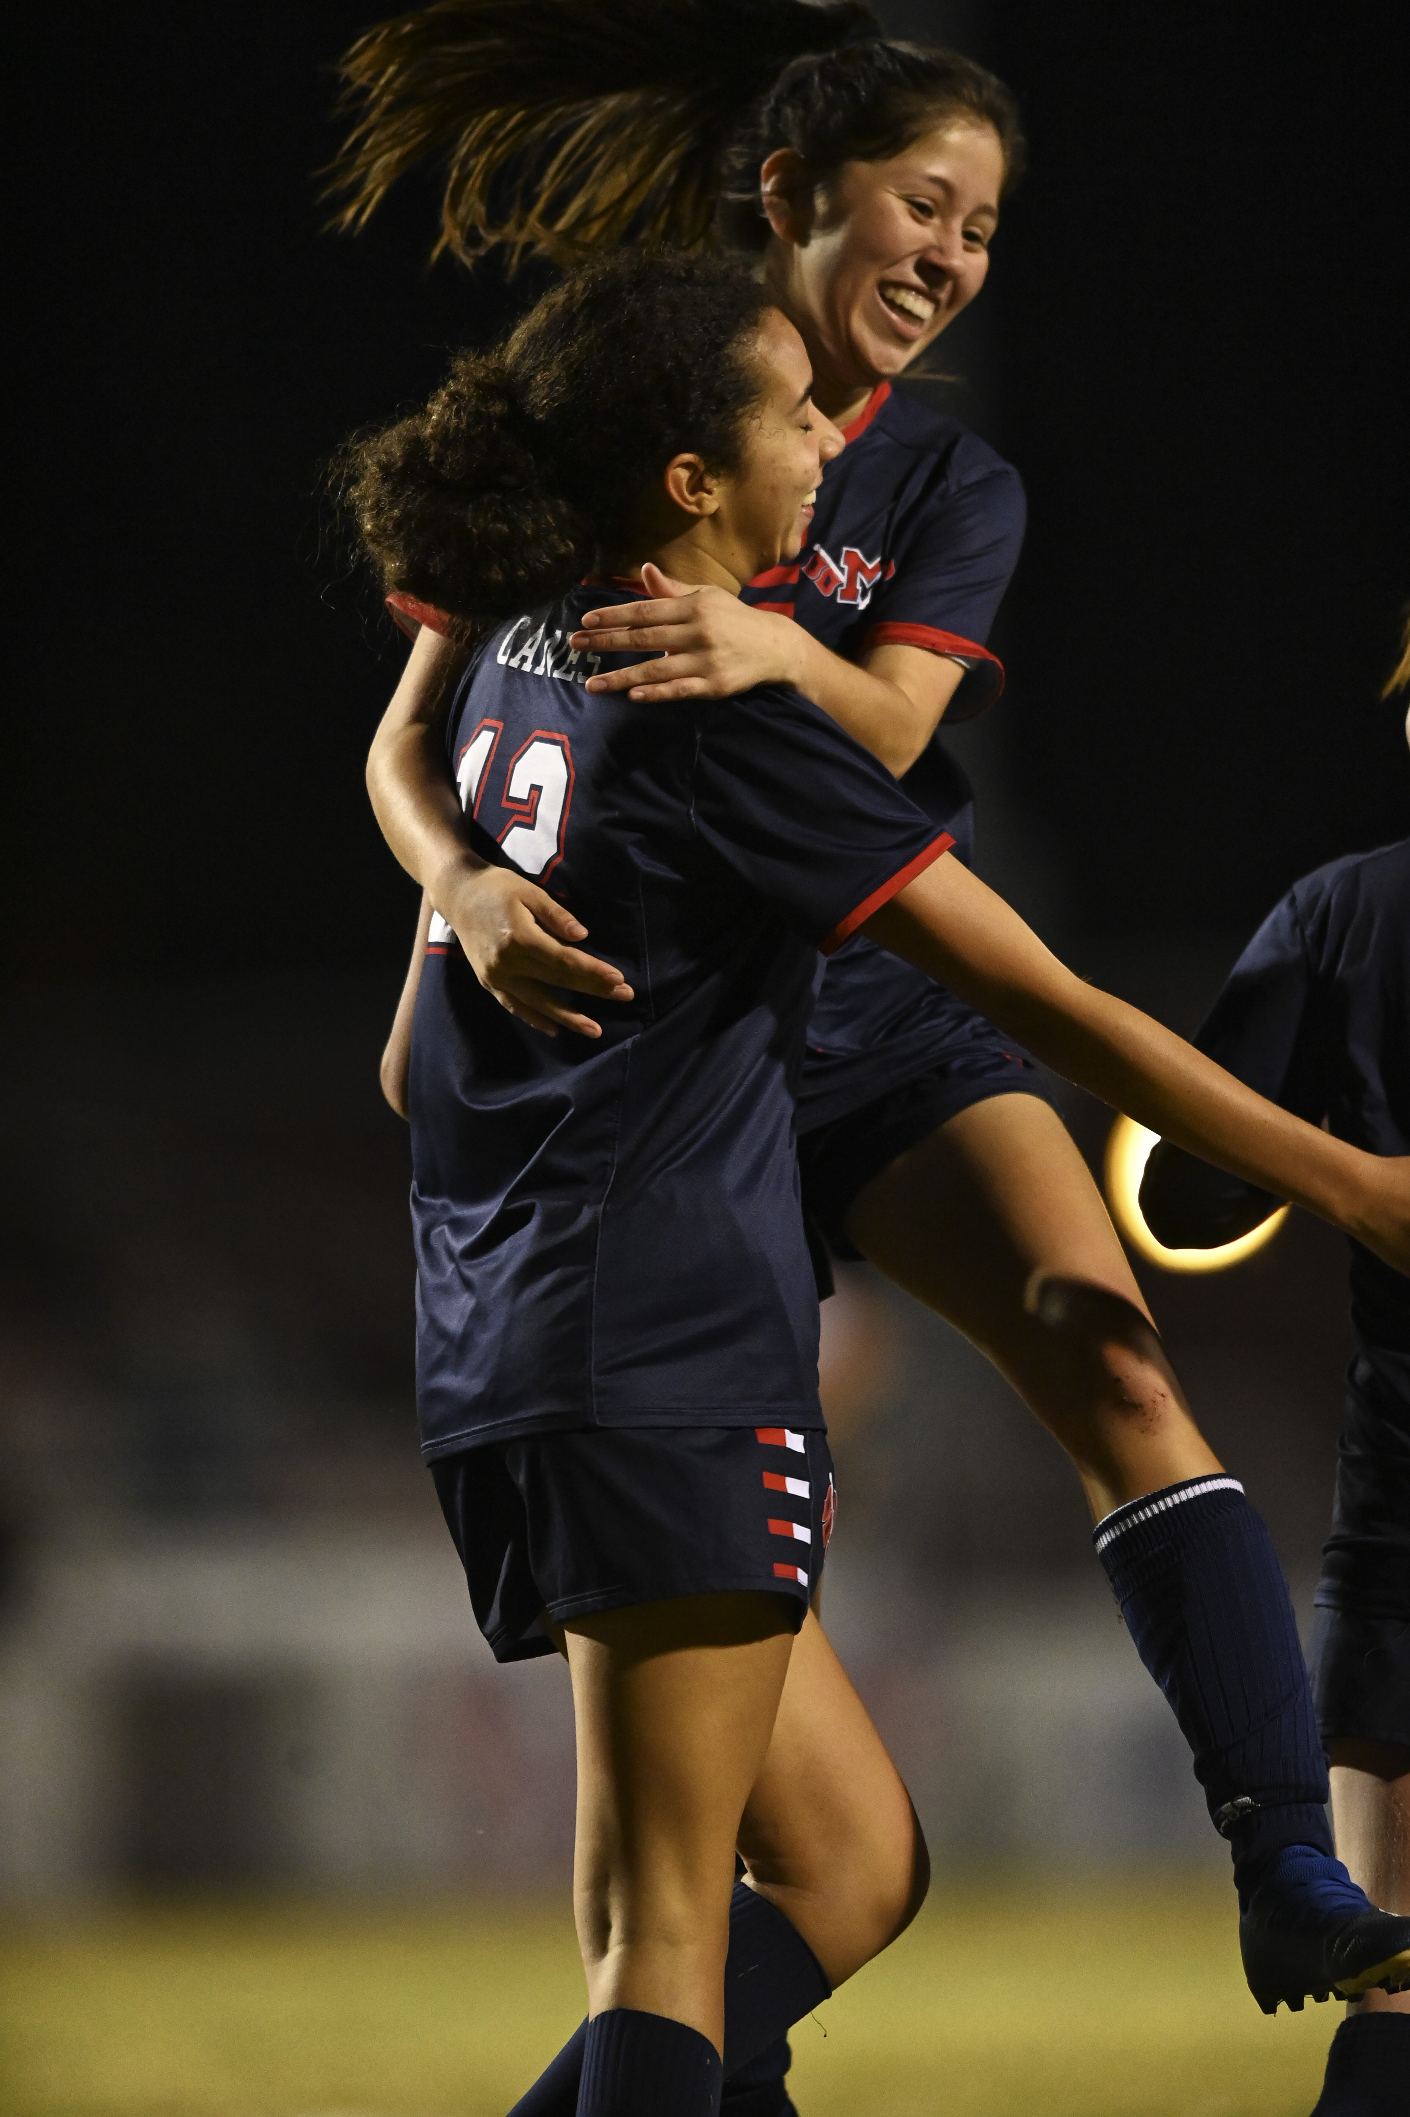
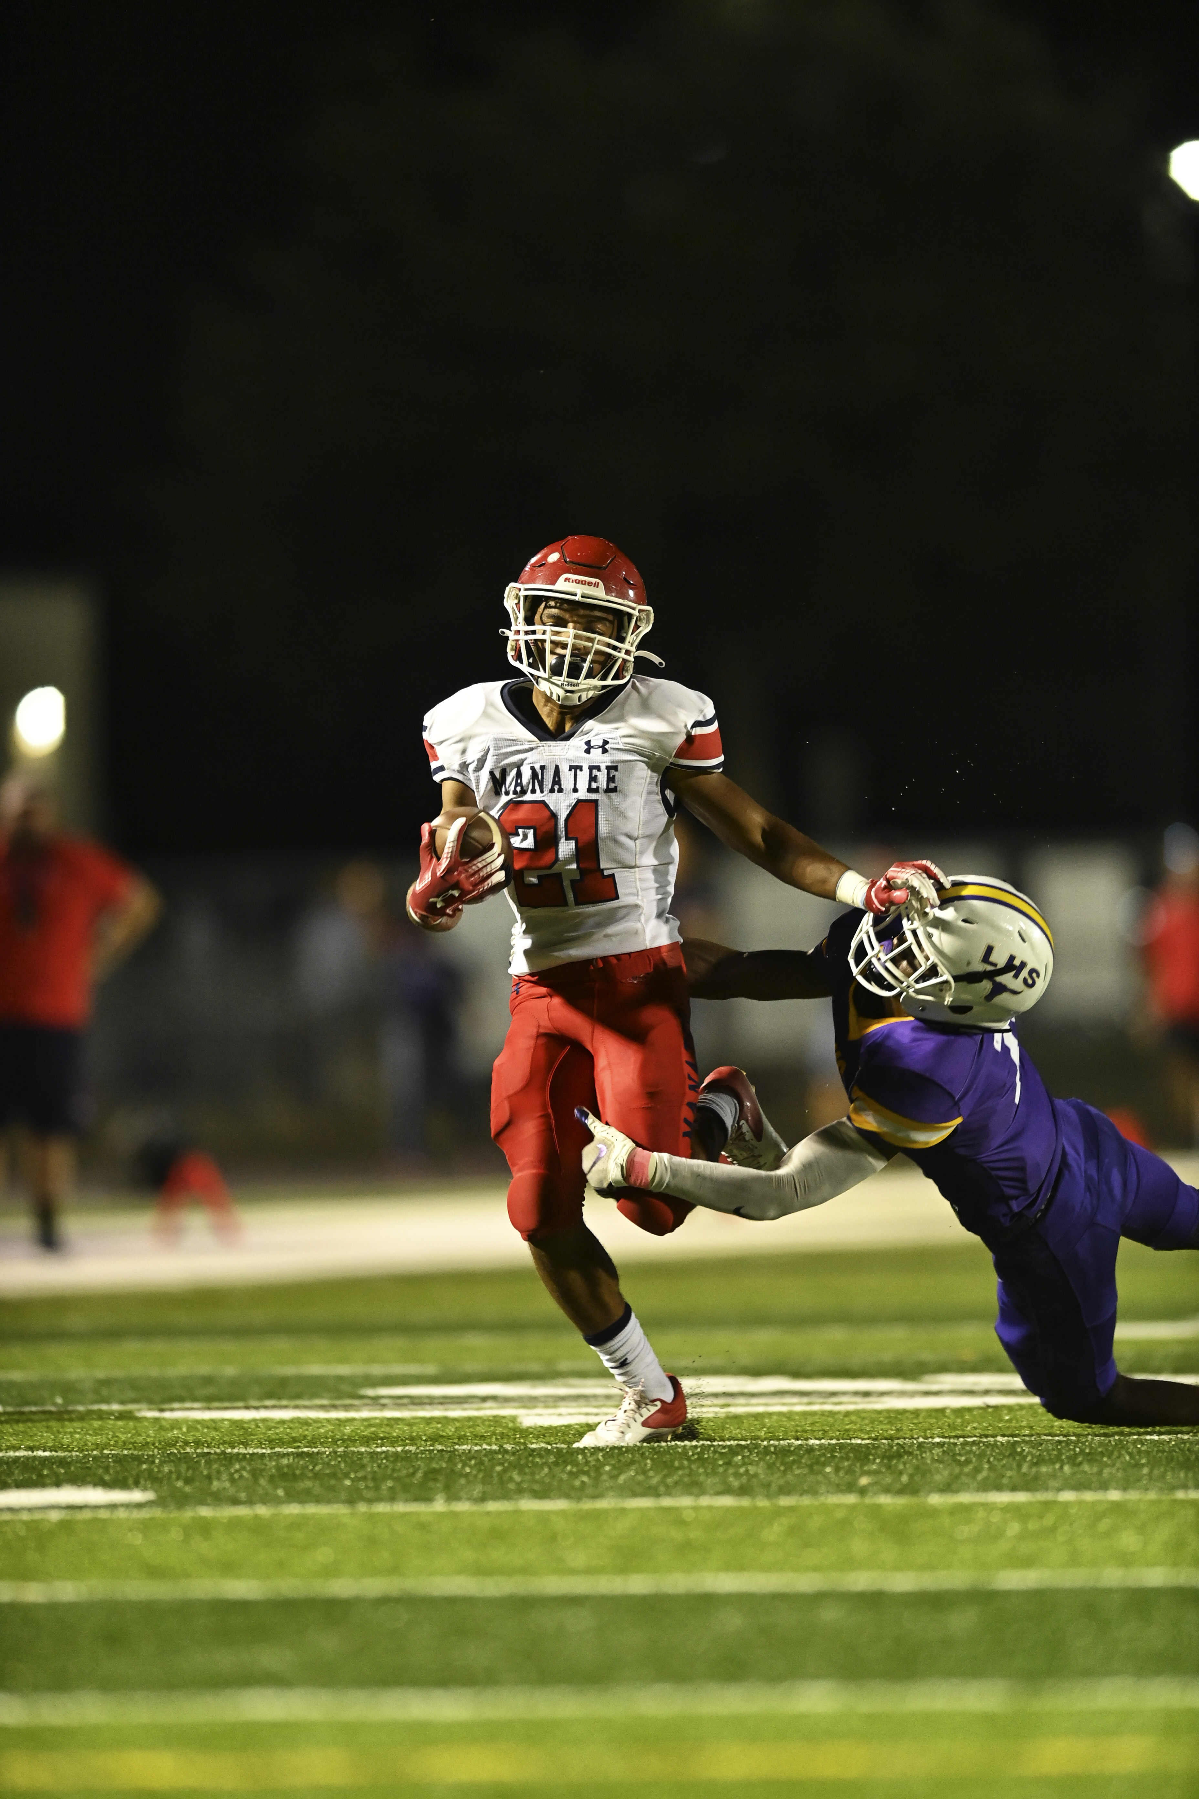
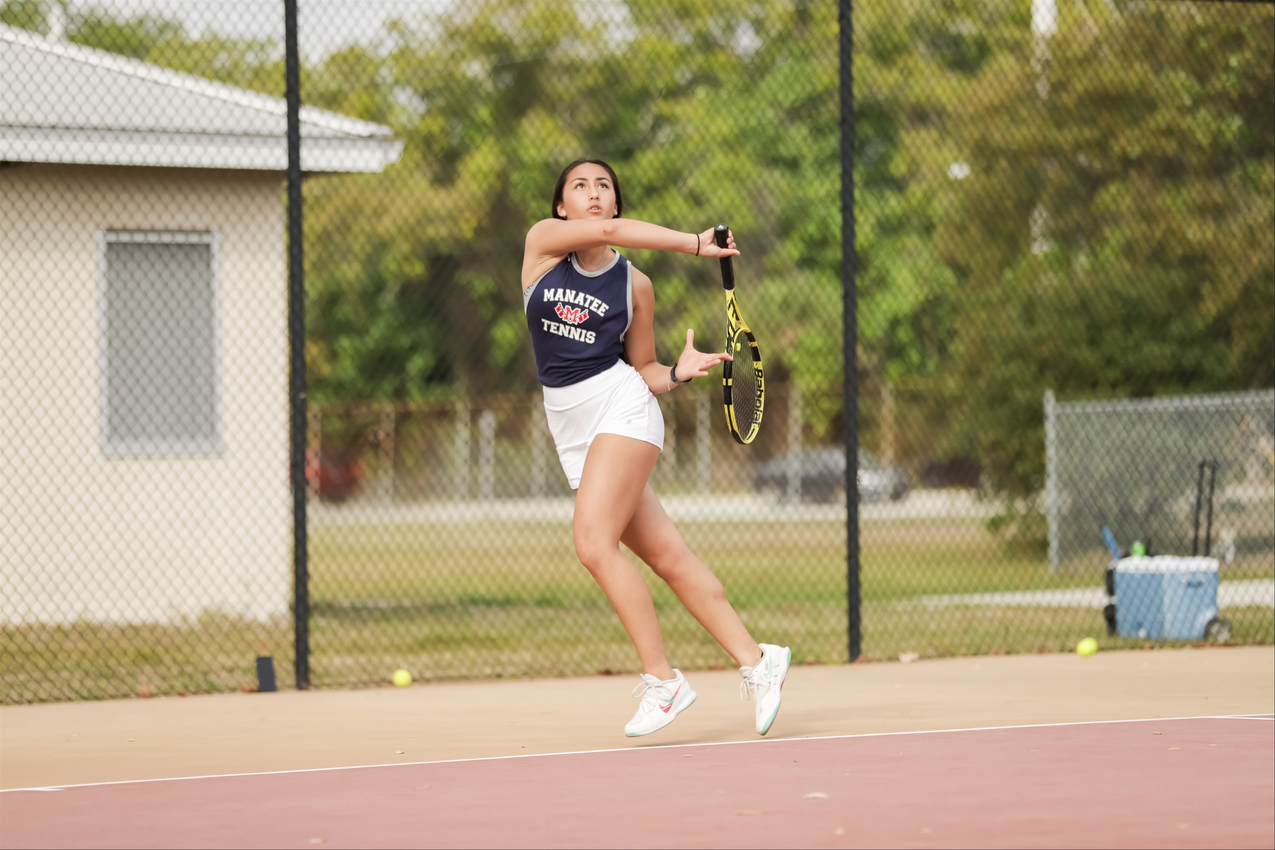
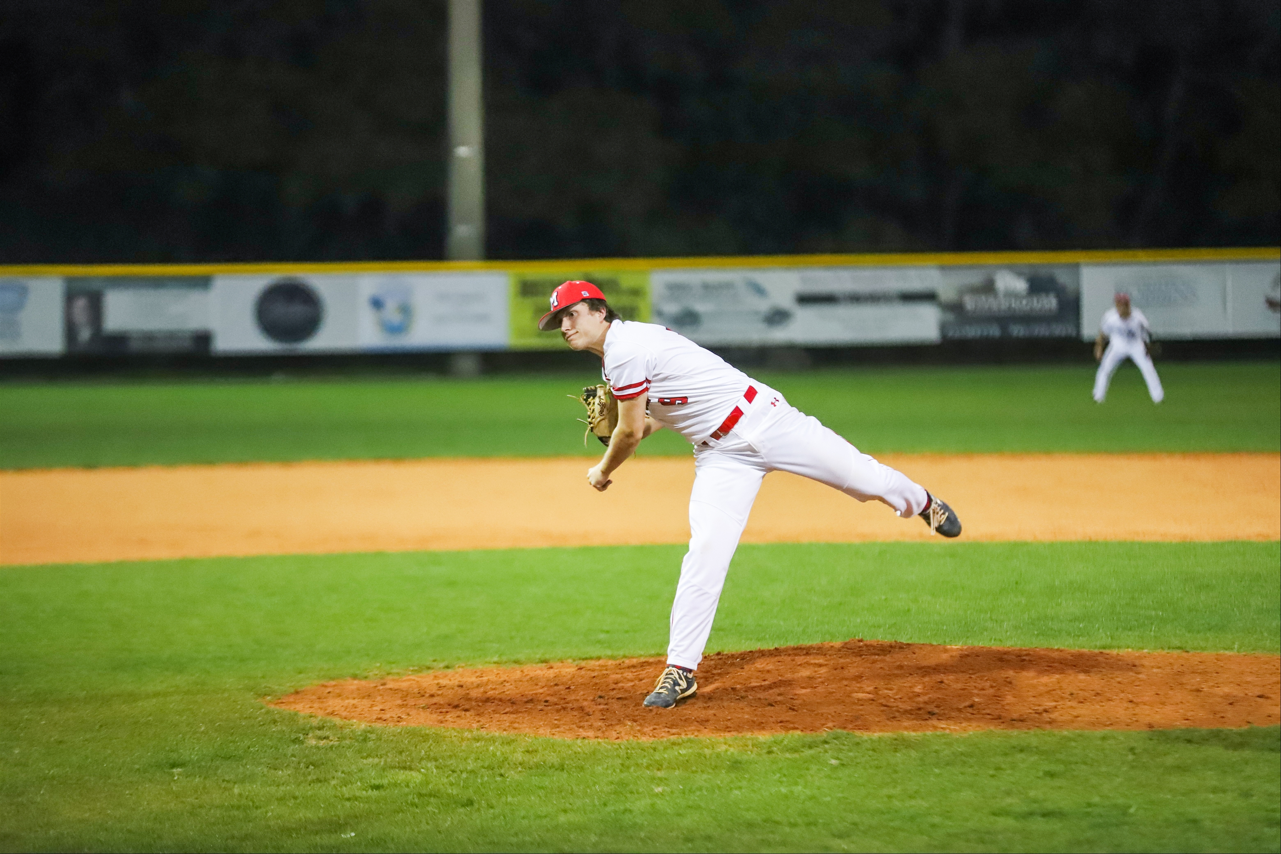
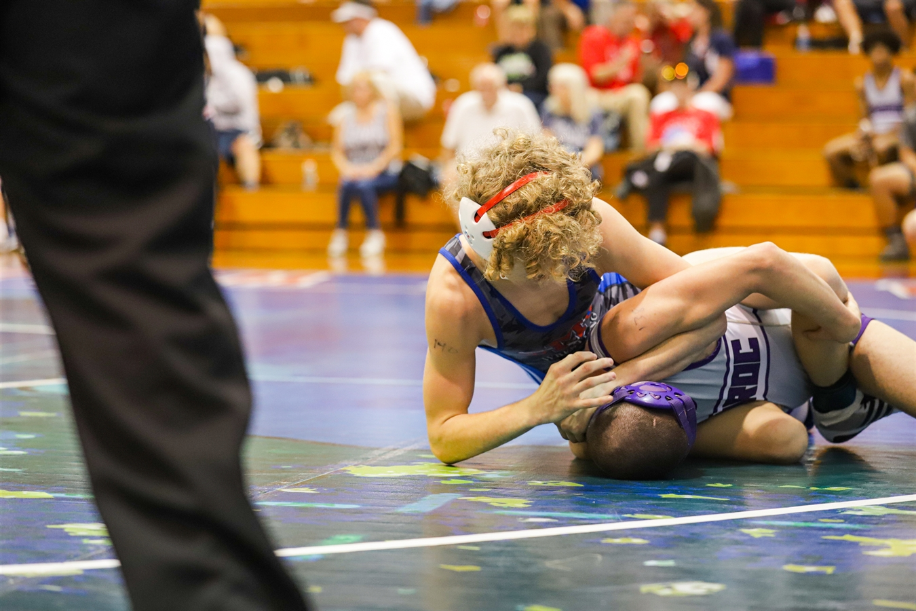
MANATEE ATHLETICS
SPORTS ORIENTATION

Slide 2
ADMINISTRATION
MRS. SHARON SCARBROUGH- PRINCIPAL
MS. DENISE BRIGG- ASSISTANT PRINCIPAL
MR. TRAVIS COCHRAN- ASSISTANT PRINCIPAL
MR. SHANE HALL- ASSISTANT PRINCIPAL

Slide 3
ATHLETIC DIRECTOR
MR. MATT BOWLING
941-714-7300 EXT 71923
BOWLINGM@MANATEESCHOOLS.NET

Slide 4
MHS SPORTS PROGRAMS
ALL SPORTS OPERATE UNDER THE GOVERNANCE OF THE FLORIDA HIGH SCHOOL ATHLETIC ASSOCIATION (FHSAA)
MANATEE HIGH OFFERS 26 COMPETITIVE ATHLETIC TEAMS
VARSITY AND JUNIOR VARSITY LEVELS OFFERED
MHS COMPETES IN THREE SPORT SEASONS:
FALL
WINTER
SPRING

Slide 5
FALL SPORTS
BOYS | GIRLS
CROSS COUNTRY | CROSS COUNTRY
FOOTBALL | GOLF
GOLF | SWIMMING
SWIMMING | VOLLEYBALL
Boys XC: Krista Latessa
Girls XC: Krista Latessa
Football: Jacquez Green
Boys Golf: Charlie Gage
Girls Golf: Daniella Gordic-Ronderos
Swimming: Michelle Armer
Volleyball: Tony Cothron

Slide 6
WINTER SPORTS
BOYS | GIRLS
BASKETBALL | BASKETBALL
COMPETITIVE CHEER | COMPETITIVE CHEER
SOCCER | SOCCER
WRESTLING | WRESTLING
Boys Basketball: Mike Alderson
Girls Basketball: Latece Luther
Cheerleading: Giovanna Scialdone
Boys Soccer: TBD
Girls Soccer: Jeff Wandel
Girls Weightlifting: Rich Lansky
Boys Wrestling: Andrew Gugliemini
Girls Wrestling: Andrew Gugliemini
WEIGHTLIFTING
WEIGHTLIFTING

Slide 7
SPRING SPORTS
BOYS | GIRLS
BASEBALL | BEACH VOLLEYBALL
LACROSSE | FLAG FOOTBALL
TENNIS | LACROSSE
TRACK AND FIELD | SOFTBALL
WEIGHTLIFTING | TENNIS
 | TRACK AND FIELD
Baseball: Nolan Neiman
Beach Volleyball: TBD
Flag Football: John Johnson
Boys Lacrosse: Neil Roche
Girls Lacrosse: Jeff McGuigan
Softball: Krista Latessa
Boys Tennis: Alan Johnson
Girls Tennis: Alan Johnson
Boys Track and Field: Domonique Dunbar
Girls Track and Field: Kavious Price
Boys Weightlifting: Rich Lansky

Slide 8
REQUIRED ATHLETIC FORMS
EVERY ATHLETE MUST SUBMIT REQUIRED FHSAA DOCUMENTATION PRIOR TO STARTING ANY SPORT.
OFF-SEASON/SUMMER WORKOURTS REQUIRE SAME DOCUMENTATION
INSURANCE MUST BE PAID PRIOR TO BEGINNING ANY SPORT
PLEASE AQUIRE DOCUMENTATION ONLY FROM THE MHS WEBSITE OR WWW.FHSAA.COM

Slide 9
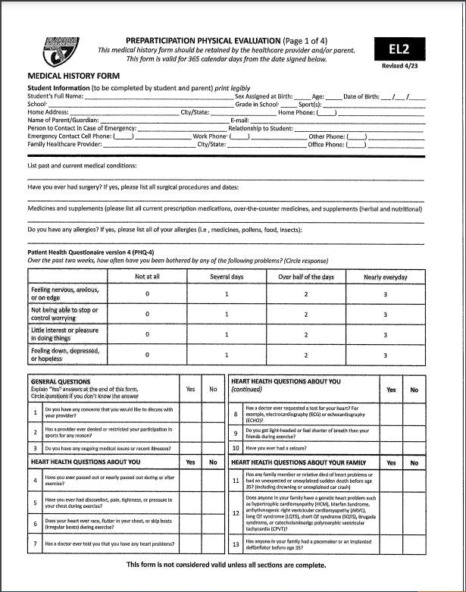
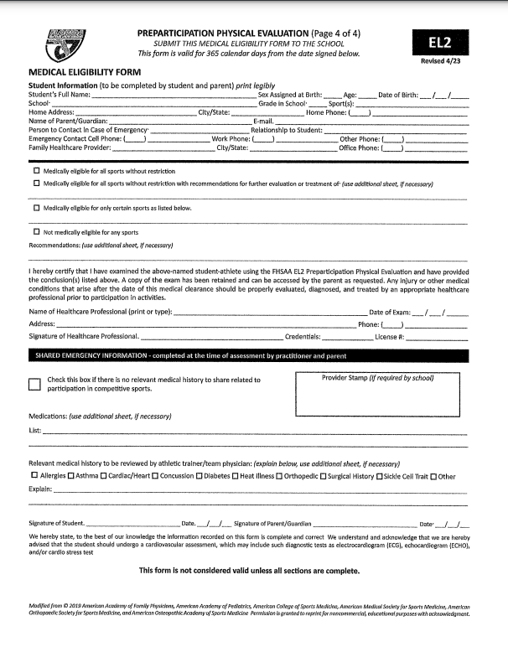
FHSAA: EL2 (PHYSICAL)
ALL ATHLETES MUST HAVE A PHYSICAL CONDUCTED BY A LICENSED MEDICAL PRACTITIONER
PHYSICALS ARE CURRENT FOR 365 DAYS FROM EXAM

Slide 10
FHSAA: EL-3
5 PAGES TO THIS DOCUMENT
DOCUMENT MUST SAY REVISED 4/23 IN UPPER RIGHT CORNER
ALL PAGES MUST BE SIGNED AND DATED BY STUDENT ATHLETE
ALL PAGES MUST BE SIGNED AND DATED BY PARENT/GUARDIAN

Slide 11
EL-3:
Page 1: CONSENT AND RELEASE FROM LIABILITY CERTIFICATE
Page 2: CONCUSSION
Page 3: SUDDEN CARDIAC ARREST
Page 4: HEAT ILLNESS
Page 5: ACKNOWLEDGEMENT

Slide 12
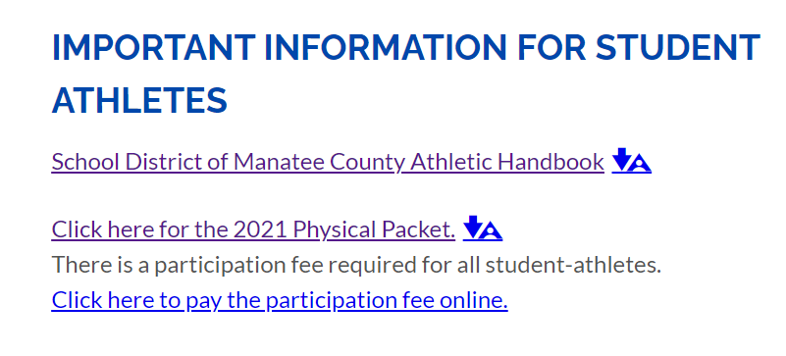
Athletic participation fee
VISIT MANATEE WEBSITE
CLICK ATHLETICS TAB
SCROLL TO BOTTOM
CLICK ON PARTICIPATION FEE LINK

Slide 13
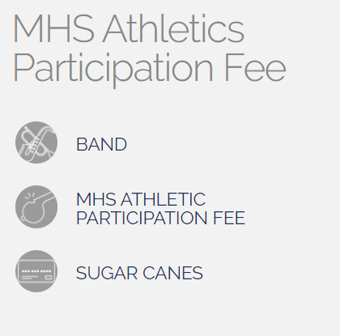
Paying participation fee
CHOOSE APPROPRIATE SELECTION
CHOOSE FEE FROM DROP DOWN MENU
FOOTBALL- $75.00
ALL OTHER ACTIVITIES- $50.00
SPRING ONLY- $25.00

Slide 14
Non-traditional students
IF YOU ARE ENROLLED AT A CHARTER SCHOOL, PLEASE SEE THE ATHLETIC DIRECTOR PRIOR TO BEGINNING A SPORT
IF YOU ARE A HOME SCHOOL STUDENT, PLEASE CONTACT THE ATHLETIC DIRECTOR PRIOR TO BEGINNING A SPORT
FLVS FLEX IS CONSIDERED A HOME SCHOOL PROGRAM
ALL NON-TRADITIONAL STUDENTS MUST COMPLETE ADDITIONAL PAPERWORK FOR THE FHSAA
ALL PAPERWORK CAN BE FOUND ON OUR WEBSITE

Slide 15
Athletic injuries
ATHLETIC TRAINER: BRIAN WATERS
ATHLETES NEED TO SEE TRAINER FIRST WHEN INJURED
TRAINER WILL REFER TO DOCTOR IF NEEDED
ALL ATHLETES MUST HAVE CLEARANCE FROM DOCTOR TO PARTICIPATE

Slide 16
ELIGIBILITY
ALL ATHLETES MUST MAINTAIN AN UNWEIGHTED CUMULATIVE 2.0 GPA
GPA ON THE FIRST DAY OF EACH SEMESTER DETERMINES ELIGBILITY
SPEAK WITH COUNSELOR IF DOING CREDIT RECOVERY. ALL CREDIT RECOVERY MUST BE COMPLETED PRIOR TO THE FIRST DAY OF SCHOOL.
ATTENDANCE IN SCHOOL IS MANDATORY TO ATTEND AN ATHLETIC EVENT
MUST BE IN ATTENDANCE FOR AT LEAST HALF OF THE SCHOOL DAY
ATHLETIC EVENT IS PRACTICE AND GAMES
ONLY DOCUMENTED ABSENCES ARE ACCEPTED FOR CONSIDERATION

Slide 17
Athlete EXPECTATIONS
MANATEE HIGH SCHOOL EXPECTS THAT ALL ATHLETES REPRESENT THE FOLLOWING IN HIGH REGARD AT ALL TIMES:
FAMILY
SCHOOL
TEAM
TEAMMATES
ANY ACT THAT EMBARRASES THE TEAM, ATHLETIC DEPARTMENT, OR SCHOOL MAY RESULT IN A REMOVAL FROM ATHLETICS FOR UP TO 180 CALENDAR DAYS.

Slide 18
ATHLETIC SUSPENSIONS
SCHOOL DISTRICT OF MANATEE COUNTY OPERATES A 180 DAY SUSPENSION FROM ATHLETICS
DRUG ISSUES ON OR OFF CAMPUS MAY RESULT IN AN AUTOMATIC 180 DAY SUSPENSION
ALL LEVEL 3 AND LEVEL 4 OFFENSES ON THE SCHOOL DISTRCIT OF MANATEE COUNTY DISCIPLINE MATRIX MAY RESULT IN A 180 DAY SUSPENSION
CRIMINAL CHARGES RESULT IN AUTOMATIC SUSPENSION UNTIL A RESULT IS REACHED
ANY ATHLETE CONVICTED OF A FELONY WILL BE REMOVED FROM ATHLETICS FOR THE DURATION OF THE ATHLETE’S HIGH SCHOOL CAREER

Slide 19
Coaching concerns
ENCOURAGE YOUR ATHLETE TO SPEAK WITH COACH
PLAYING TIME WILL NOT BE DISCUSSED
COACHING STRATEGY/PHILOSOPHY WILL NOT BE DISCUSSED

Slide 20
CHAIN OF COMMAND WITH COACHES
CONFERENCE WITH PLAYER AND COACH
CONFERENCE WITH PLAYER, PARENT AND COACH
CONFERENCE WITH PARENT, PLAYER, COACH, AND ATHLETIC DIRECTOR
CONFERENCE WITH PARENT, PLAYER, COACH, AD, AND PRINCIPAL
CONFERENCE WITH PARENT, PLAYER, COUNTY AD AND EXECUTIVE DIRECTOR FOR FINAL RULING

Slide 21
PARENT INVOLVEMENT
SUPPORT
GET INVOLVED
SUPPORT
ENCOURAGE
SUPPORT

Slide 22
QUESTIONS
IF YOU HAVE QUESTIONS, PLEASE REACH OUT TO COACH BOWLING
PHONE- 941-714-7300 EXT 71923
EMAIL- BOWLINGM@MANATEESCHOOLS.NET

